Slide 1
15 Years Strong. Now going digital!

Slide 2
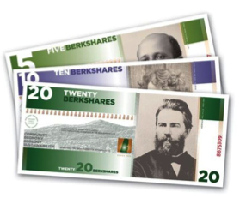
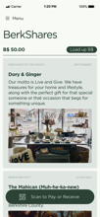
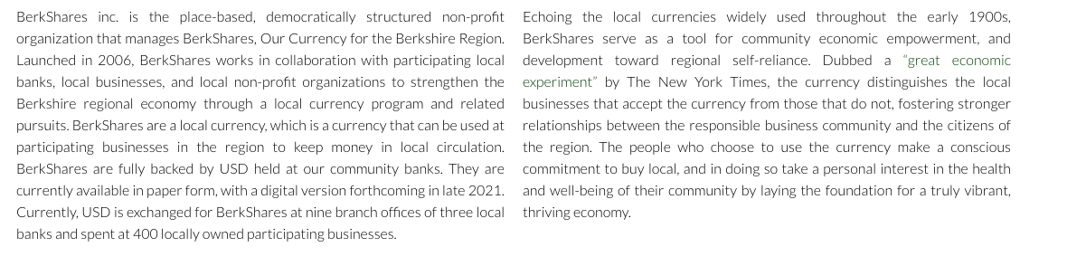
Having helped sustain and grow the Berkshire economy for 15 years, BerkShares local currency is expanding to a mobile payments app.

Slide 3
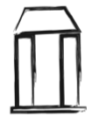
COVID has exacerbated the inequality gap between Big Business and Big Banks that hurt our local small businesses and community banks. Real economic value leaks out of the region to global online retailers and financial firms.
Harder to get loans
SMALL BUSINESSES
Harder to get new local customers
COMMUNITY BANKS
Number of new businesses halved since the 1980s
Lose business to Amazon and other cut-rate online retailers
Pay $10,000s+ per year in extractive credit card processing fees
50% of Community Banks nationally closed since 2000
Funds held with other banks and apps like Venmo or Paypal fund Wall St. speculation rather than sustainable local enterprise
Regional wealth leakage

Slide 4
Adopting BerkShares encourages circularity—keeping more of the region’s wealth working locally.
Everyday citizens are increasingly seeking ways to shop locally, eat local produce, and share in community
As a local currency, BerkShares taps into that intent and provides a conduit for committed local exchange
As more small businesses accept and pay expenses through BerkShares, a larger share of county economic activity remains within the community
By leveraging emerging blockchain technology, BerkShares offers a payment solution that saves businesses money compared to credit card processing and is competitive with Venmo’s cash out fees.

Slide 5
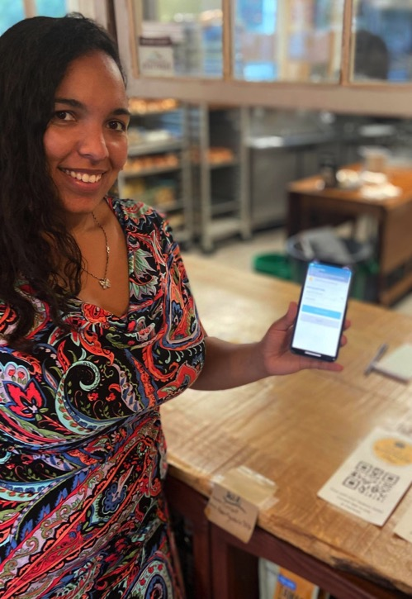
Digital BerkShares are easy to use and accept
Venmo-style app with QR code scanning, available on both iOS and Android phones
Easier to set up and use than EBT
No transaction fees to accept and use BerkShares
Small 1.5% fee to redeem back to USD (cheaper than credit cards and no chargebacks)
No new equipment needed: can accept BerkShares using a static QR code or the app with an existing phone or tablet
Businesses can easily recirculate BerkShares by paying suppliers and employees through the app
There are already more than 400 BerkShares businesses

Slide 6
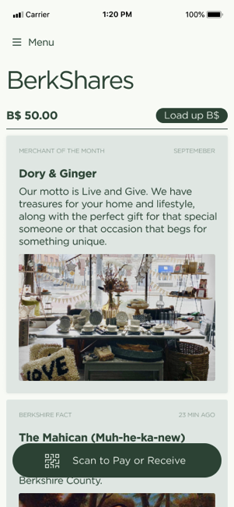
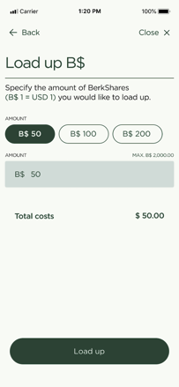
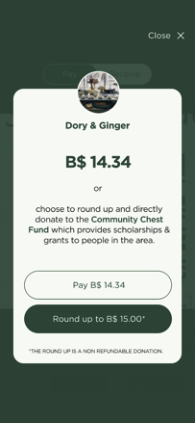
The BerkShares app: available on iPhone and Android
Link up your bank account to easily load your wallet
Scan & Pay, round up and donate your change to fund UBI in your community

Slide 7
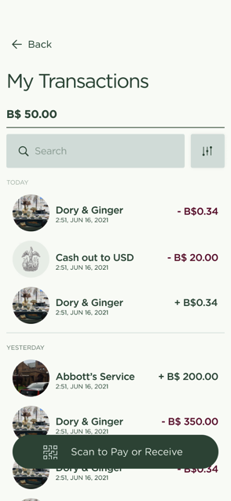
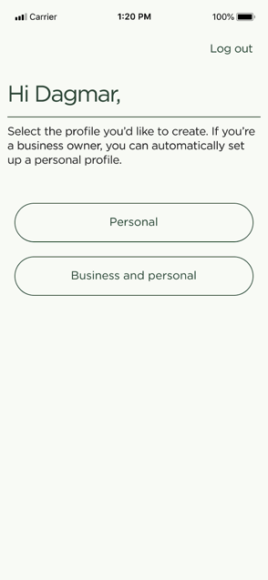
Toggle Seamlessly Between Personal and Merchant Accounts
Add a business profile to accept BerkShares at your business; manage both personal & business profiles under one account
Manage transactions, including receipts to return items

Slide 8
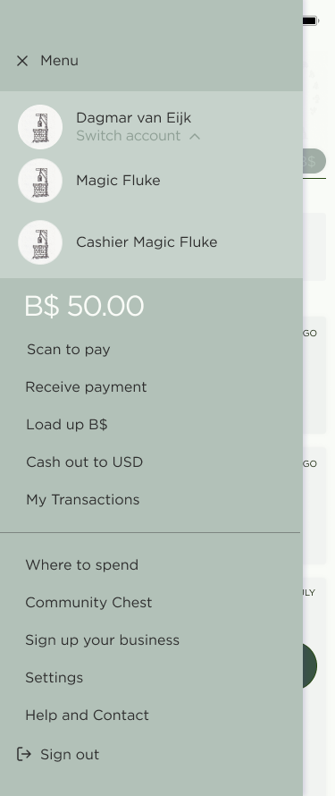
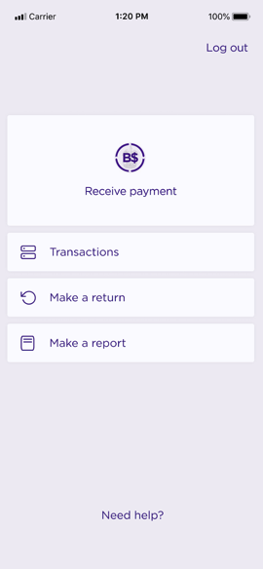
Merchant Accounts Include a Cashier View
CASHIER VIEW
Easily switch to your business profiles, which includes an admin view and a cashier view with limited capacity and security control

Slide 9
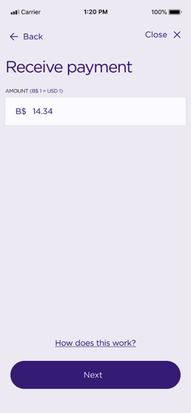
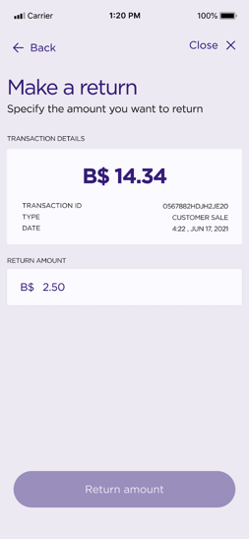
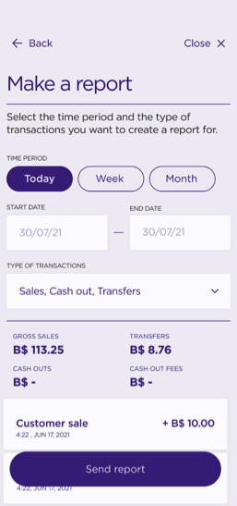
The BerkShares App Includes Return and Reporting Functions
Manage admin functions such as cashing out to USD, paying vendors in BerkShares and making reports for taxes and accounting
Transact payments, make returns & corrections

Slide 10
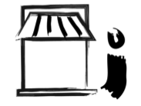
Vision: Community Wealth on Both Sides of your BerkShares
Small businesses, non-profit and citizen spending
Community Banks Saved B$ reserves
Loan capital for lower-risk local investments
BerkShares in circulation keeps money working within the region
BerkShares are backed by US Dollars in reserve at Lee Bank and Salisbury Bank
Loans to independent ventures and farms
Opportunities for local procurement identified in digital BerkShares data

Slide 11
Launch Timeline
November
Finalize 1.0 app development
Sign up launch business partners
Period to set up launch business profiles and schedule cashier/business owner trainings
December
Distribute 60K in B$ launch incentives to drive early adoption and use
Direct outreach at holiday markets and events + partnership with CozQuest scavenger hunt
January
Public launch event at Mahaiwe
Start of media campaign through January
Mid-2022
Goal: meet and exceed print BerkShares adoption

Slide 12
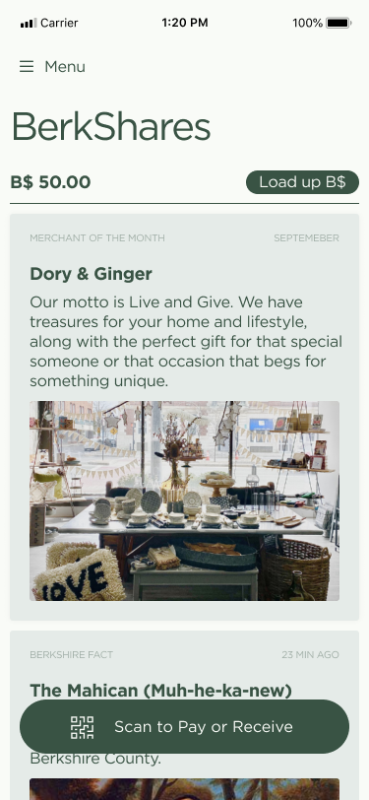
Further Feature Development
Beyond the initial launch, a product roadmap is in place to develop new features which will further expand the app’s utility:
Enabling merchant promotions and discounts featured on the app home screen
Enabling community announcements (e.g. farmers market schedules, CSA schedules)
Integrating with community event calendars to display in-app
Loyalty programs for specific interests (e.g., a BerkShares Culture Pass)
More ideas incorporating local business needs and gaps
The vision is for the BerkShares app to become a hub for shopping, eating, and living local for a vibrant and sustainable regional economy.

Slide 13
Business Benefits of Joining the Digital BerkShares Launch
A network of local businesses committed to a vibrant Berkshires economy
A county-wide marketing outlet at no additional cost
Local and national press opportunities
Share in the revenues generated by the B$ 60K incentive through Q1 2022
A voice in future feature development
Facilitate brand loyalty

Slide 14
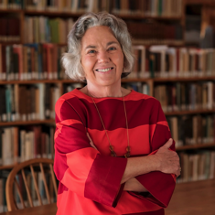
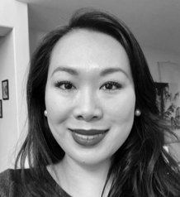
Team Leads
Tech & legal
Community building
Rachel Moriarty
Operations Director, Schumacher Center
Susan Witt
Executive Director, Schumacher Center
Jared Spears
Marketing Director, Schumacher Center
Fennie Wang
Founder & CEO, Humanity Cash
Has managed BerkShares, Inc. and Schumacher Center Local Currency operations since 2015
Administers the budget and Board for BerkShares, Inc.
Founder of the Schumacher Center, est. 1980
Creator of BerkShares local currency in 2006
Local leader and advocate for community land trusts and local currencies
Seven years of consumer marketing experience launching digital products and new app features
Nationally published writer on economic and climate justice issues
Advisor to The Danish Red Cross and NY State Assemblyman Ron Kim on Digital Currencies
Formerly a securities lawyer and Research Analyst
J.D. from Columbia University

Slide 15
For more information and to sign up, visit BerkShares.org.
For questions, please contact info@berkshares.org.
Thank you.

Slide 16
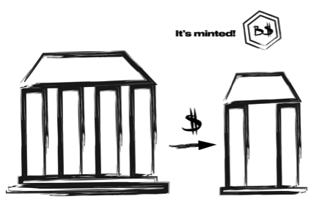
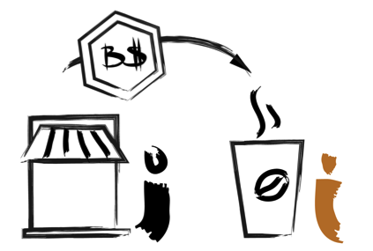
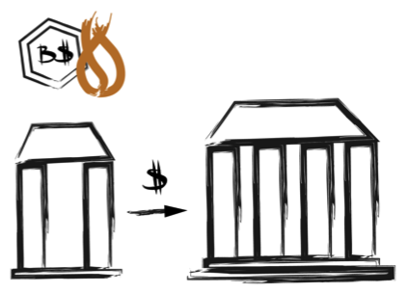
Appendix: BerkShares Currency Design
Once funds are received, BerkShares tokens are created, representing a user’s wallet balance (like a prepaid gift card).
+Blockchain transaction
Step 1: User loads wallet
US dollars transferred from user’s bank account to a BerkShares bank.
+Dwolla ACH transfer
Step 3: User redeems BerkShares
Step 2: Transact in BerkShares
USD is transferred from a BerkShares bank to user’s bank account
+ ACH transfer
User’s BerkShares wallet balance is immediately reduced accordingly.
+Blockchain transaction
BerkShares tokens (wallet balances) are transferred via scan-to pay payments over a peer-to-peer network, which reduces transaction costs for merchants.
+Blockchain transaction

